Slide 1

CivicMind – AI based centralized Municipal grievance management system
SDG goals - SDG11, SDG16
Category- Software
Group No - 7
Group Members – Ved Sawant, Vinay Patil, Pranay Bhere, Umesh Phulare.
Guide – Prof. Radhika B.

Slide 2
Introduction
Innovative Technological Foundation
CivicMind delivers an AI-driven framework engineered for modern urban management complexities. Machine learning automates the grievance lifecycle from reporting to resolution, ensuring scalability during data surges.
Operational Excellence and Governance
The platform eliminates manual administrative friction through intelligent data processing, bridging gaps between municipal departments and residents for more responsive, precise governance.
Empowering Citizen Engagement
A transparent, user-centric interface enables real-time tracking and clear communication, transforming residents from passive observers into active participants who trust public institutions.

Slide 3
Literature Survey
Year | Author | Title | Technologies Used | Description
2023 | K. Verma et al. | Smart City Complaint Management System | Web Portal, MySQL, PHP | This system proposes a centralized complaint portal for smart cities where citizens can submit complaints online. It improves accessibility but lacks AI-based complaint classification and automated routing mechanisms.
2024 | R. Singh et al. | AI-Based Grievance Redressal System | NLP, ML Classification, Web APIs | The study uses NLP to categorize complaints automatically into predefined departments. While it enhances automation, it does not include image verification or real-time employee workload balancing.
2023 | M. Patel & A. Joshi | Civic Issue Reporting Using Mobile App | Android App, GPS Tagging, Firebase | This work focuses on mobile-based civic reporting with GPS tagging and status tracking. However, complaint assignment remains manual and no severity detection mechanism is implemented.
2024 | S. Khan et al. | Automated Complaint Routing System | Rule-Based Engine, Cloud Database | The system automates routing using rule-based mapping of complaint categories to departments. It improves routing efficiency but lacks AI-driven urgency detection and deduplication features.
2022 | J. Brown et al. | Image-Based Urban Issue Detection | CNN, Computer Vision | This research applies CNN models to detect urban infrastructure issues from images. It improves issue recognition accuracy but does not integrate full complaint lifecycle management or citizen feedback loops.

Slide 4
Literature Survey
Year | Author(s) | Title | Technology Used | Description
2024 | Anurag Saha, Aadarsh Chaure, Aayush, Aditya Bodhe, Prof. T.D. Bhagat | Automated Complaint Classification and Routing Using NLP and Machine Learning | TF-IDF, BERT, Logistic Regression, SVM, Random Forest, KNN, Naive Bayes | Proposes an automated complaint classification and routing system using NLP and ML techniques. Uses TF-IDF and BERT embeddings for feature extraction and compares classical ML models with deep learning models. Demonstrates improved routing efficiency and reduced manual workload.
2022 | Dnyanesh Walwadkar, Jayesh Patil, Mujahid Hussain, Saurav Yadav | Smart Civic Issue Reporting System | Android App, CNN-RNN Hybrid Model, SVM-NLP, GPS, Cloud Computing | Develops an Android-based civic issue reporting system. Uses a hybrid CNN-RNN image processing algorithm and SVM-based NLP model to detect complaint severity. Incorporates GPS for geo-location and cloud backend for routing complaints to authorities.
2025 | C. Ashwitha, K. Vani | Smart Civic Complaint Analyzer Using Natural Language Processing | Python, Streamlit, TF-IDF, Multinomial Naive Bayes, Pandas, Word Cloud | Presents a web-based civic complaint analyzer. Uses NLP techniques for complaint classification and urgency detection. Implements TF-IDF and Naive Bayes for categorization and provides dashboards with visualization tools such as pie charts and word clouds.
2025 | Catalina Sierra, Fernando Huanca, Mario Torres, Felipe Núñez | An Integrated Complaint Management System Based on Large Language Models: Case Study in the Electric Sector | Large Language Models (BERT, BETO, BERTIN, ALBERT, GPT-4o, LLaMA 3.1), Ensemble Voting, Redis, ArangoDB, Service-Oriented Architecture | Proposes an end-to-end automated complaint management system using fine-tuned LLMs. Employs ensemble classification and complaint summarization. Designed for electricity sector complaints with scalable microservice architecture and performance evaluation.
2018 | Siripen Pongpaichet, Pattamaporn Kormpho, Panida Liawsomboon, Narut Phongoen | Smart Complaint Management System (SCMS) | Mobile App, Chatbot, Web Application, Machine Learning (Naive Bayes, SVM), Cloud Computing | Introduces SCMS integrating mobile app, chatbot, and web dashboard. Uses ML-based complaint classification and duplicate detection. Improves complaint tracking, routing, and management efficiency in an academic institutional setting.

Slide 5
Limitations of Existing Systems
No urgency detection: Every complaint is treated with equal priority because the system lacks the intelligence to identify and fast-track life-threatening or time-sensitive emergencies
Manual complaint assignment: Human administrators must hand-sort every ticket, which creates a massive operational bottleneck and slows down the initial response time.
No workload balancing: Tasks are assigned without considering current staff capacity, often resulting in some employees being overwhelmed while others remain underutilized.
Limited transparency & tracking: Citizens are left in the dark about who is handling their issue or how much progress has been made, which erodes public trust in the system.

Slide 6
Problem Statement & Objectives
Problem Statement
Develop an AI-based centralized grievance management system that automates complaint verification, classification, routing, and tracking to improve municipal efficiency and transparency.
Objectives
Automate sector & urgency detection using NLP
Validate complaint images using CNN
Auto-route complaints to correct department
Assign employees based on availability
Provide real-time tracking dashboard

Slide 7
Proposed Solution
Proposed Solution: CivicMind AI
AI-powered civic issue complaint management web platform
Centralized digital platform for multiple Municipal Corporations
Web-based system with two interfaces – Citizen Portal & Municipal Portal
How It Addresses The Problem
Citizens file complaints using live camera capture + real-time location
Verifies complaint authenticity and detects urgency & sector
Complaints auto-routed to the appropriate municipal corporation and department
Innovation & Uniqueness
Automatic employee assignment based on availability & department mapping
Integrated Notice Section for official municipal announcements

Slide 8
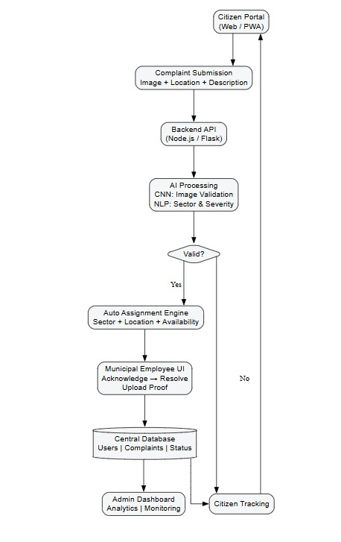
Technical Approach
Technologies Used:
Frontend: React.js, Tailwind CSS
Backend: Node.js / Fast API
Database: MongoDB
Image Processing: Pretrained CNN model
NLP: Custom-trained model
Maps & Location: Google Maps API
Methodology / Working Flow:
User feeds image + location + description
Image authenticity & relevance verification
NLP extracts sector (road, water, electric) & urgency
Complaint auto-assigned to available employee
Status updates synced across all dashboards

Slide 9
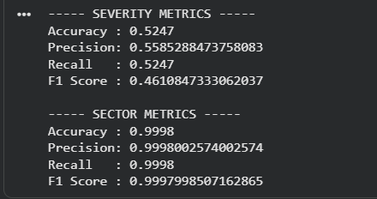
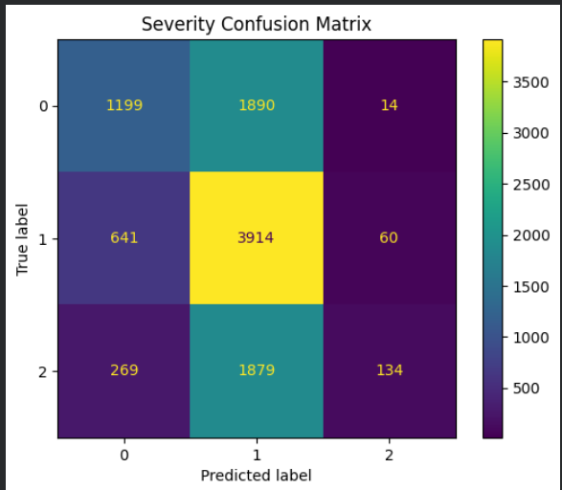
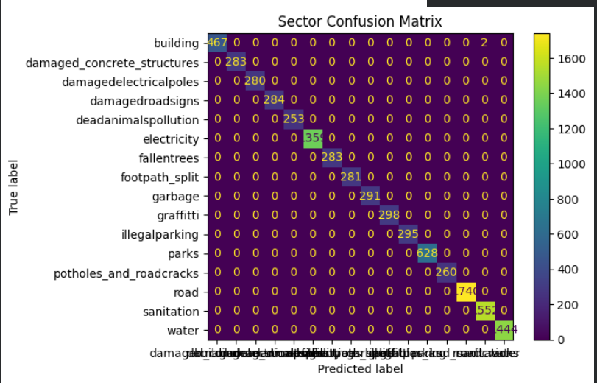
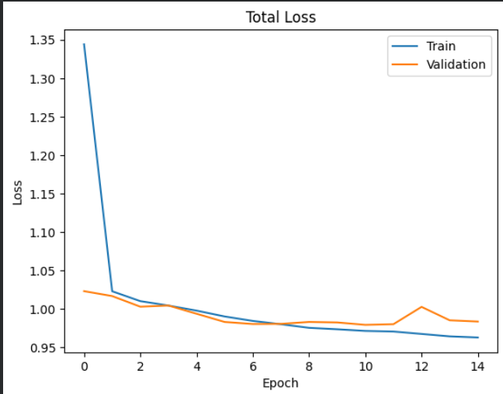
Model metrics (NLP)

Slide 10
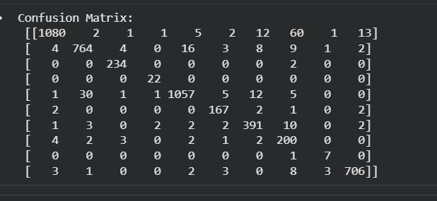
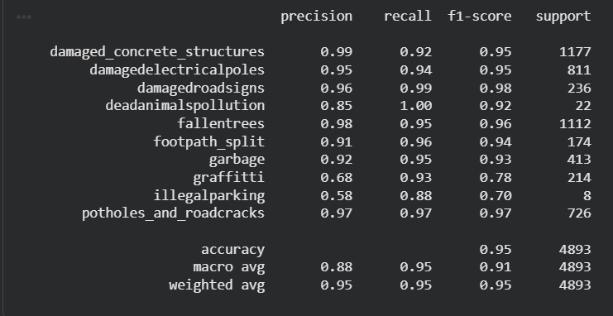
Model metrics (CNN)

Slide 11
Feasibility and Viability
Analysis of the feasibility of the idea:
Uses commonly available web & AI technologies
No additional hardware required
Can be implemented as a scalable prototype
Suitable for municipal bodies like TMC, BMC, KDMC
Potential challenges and risks:
Image verification accuracy
NLP model accuracy for sector & urgency detection
Real-time complaint routing efficiency
Strategies for overcoming these challenges:
Use pretrained CV models for image validation
Fine-tune NLP model with civic complaint datasets
Rule-based fallback for complaint assignment

Slide 12
Conclusion
Innovative Technological Foundation Civic Mind delivers an AI-driven framework engineered for modern urban management complexities. Machine learning automates the grievance lifecycle from reporting to resolution, ensuring scalability during data surges.
Operational Excellence and Governance The platform eliminates manual administrative friction through intelligent data processing, bridging gaps between municipal departments and residents for more responsive, precise governance.
Empowering Citizen Engagement A transparent, user-centric interface enables real-time tracking and clear communication, transforming residents from passive observers into active participants who trust public institutions.

Slide 13
Conclusion
CivicMind establishes an innovative, AI-driven technological foundation designed to address the growing complexities of modern urban governance. By leveraging machine learning, the platform automates the entire grievance lifecycle—from complaint reporting to resolution—ensuring scalability and efficiency even during high data surges. It enhances operational excellence by eliminating manual administrative bottlenecks through intelligent data processing, thereby streamlining coordination between municipal departments and residents for more responsive and precise governance.
Additionally, CivicMind empowers citizen engagement through a transparent, user-centric interface that enables real-time tracking and clear communication, transforming residents from passive observers into active participants who build greater trust in public institutions.

Slide 14
Impact and Benefits
Impact on Citizens
Faster grievance resolution
Transparent complaint tracking
Access to official municipal notices
Impact on Municipal Corporations
Automated complaint allocation
Balanced workload across employees
Real-time performance monitoring
Overall Benefits
Social: Improved civic participation
Operational: Reduced manual workload
Governance: Higher accountability & transparency

Slide 15
Research and References
[1] A. Saha, A. Chaure, A. Aayush, A. Bodhe, and T. D. Bhagat, “Automated Complaint Classification and Routing Using NLP and Machine Learning,” International Journal of Innovative Research in Technology (IJIRT), vol. 11, no. 6, Nov. 2024.
[2] D. Walwadkar, J. Patil, M. Hussain, and S. Yadav, “Smart Civic Issue Reporting System,” International Journal of Advanced Research in Science, Communication and Technology (IJARSCT), vol. 2, no. 1, Mar. 2022, doi: 10.48175/IJARSCT-2659.
[3] C. Ashwitha and K. Vani, “Smart Civic Complaint Analyzer Using Natural Language Processing,” International Journal of Innovative Research in Technology (IJIRT), vol. 12, no. 6, Nov. 2025.
[4] C. Sierra, F. Huanca, M. Torres, and F. Núñez, “An Integrated Complaint Management System Based on Large Language Models: Case Study in the Electric Sector,” Array, vol. 28, 2025, Art. no. 100570, doi: 10.1016/j.array.2025.100570.
[5] S. Pongpaichet, P. Kormpho, P. Liawsomboon, and N. Phongoen, “Smart Complaint Management System,” in Proceedings of the International Symposium on Intelligent Signal Processing and Communication Systems (ISPC), 2018.

Slide 16
Important Instructions
Ensure below pointers are met while preparing the PPT:
Keep the maximum slides limit up to six (6). ( Including the title slide)
Try to avoid paragraphs and post your idea in points /diagrams / Infographics /pictures
Keep your explanation precise and easy to understand
Idea should be unique and novel.
You can only use provided template for making the PPT without changing the titles of slides (mentioned in previous slides).
Note - You can delete this slide when you prepare the details of your idea

